Slide 1

Coursera Capstone
Andreas Baron Presentation

Slide 2
Business Problem
I want to consider the following situation: My friend approached me, since he wants to expand his cafe franchise to Frankfurt am Main/ Germany. Frankfurt is a city with many different kinds of cuisine: local and international and high frequency of business travelers and tourists, due to the closeness of the main airport and industry sector. Since he is not familiar with the city himself, he asked me to help him finding the perfect location. Therefore, I will use clustering algorithms, geodata and population data to find the ideal district to open his new cafe.
An ideal district must fulfill specific requirements:
It has a high population of a target age group (18 to 64)
It is accessible via public transportation
It is central
It is an area where hotels and restaurants are rather common
It is an area where cafes are not that common

Slide 3
Data I
Street Directory: https://offenedaten.frankfurt.de/dataset/strassenverzeichnis-der-stadt-frankfurt-am-main
Demographic Information: https://offenedaten.frankfurt.de/dataset/stadtteilprofile-bevoelkerung
GeoData: https://offenedaten.frankfurt.de/dataset/wahlatlas-2015-geodaten/resource/84dff094-ab75-431f-8c64-39606672f1da
Foursquare API

Slide 4
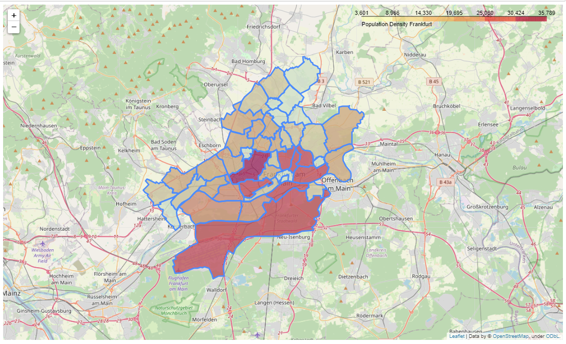
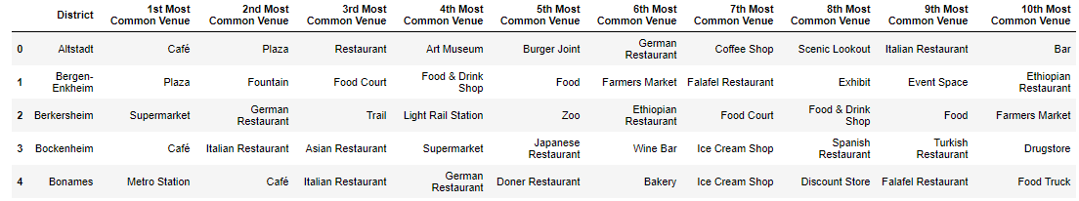
Data II
I used the geo and location data and combined it with the demographic data to plot population density in all districts of Frankfurt.
With the Foursquare API I extracted the most common venues for each district and created a dataframe with all information about venues and location data.

Slide 5
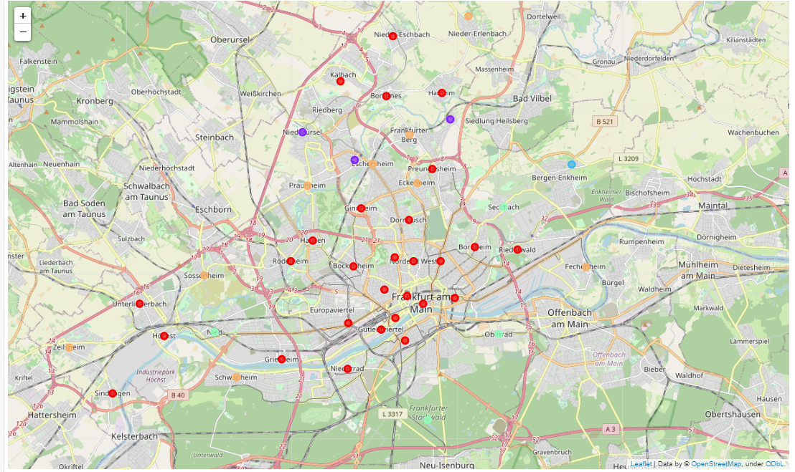
Clustering
The data was clustered with the K-Means algorithm. The best results could be achieved with a k value of 5 and a random state of 0.
Each district is distributed by color to a cluster, where one color equals the same cluster.
It can be immediately observed, that the red cluster is the biggest and most central of all clusters.

Slide 6
Analysis I
When taking a look at the tables containing the clustered data I observed, that clusters 0 and 4 are the biggest cluster by far. The rest of the clusters seem to be resident areas without many venues that belong to the three groups I am looking for: Hotels, Public Transportation, Restaurants of any kind. The reasoning behind this is as such:
Hotels: Many hotels means a lot of tourists and business travelers, therefore more customers
Public Transportation: closeness and availability of public transportation means more fluctuation of tourists or non-residents in general. Generally, customers will have an easier time reaching the café.
Restaurants of any kind: Having a lot of restaurants in the area means that people generally visit the district to eat, which means there is a higher potential customer base.
Focus on Cluster 0 and 4

Slide 7
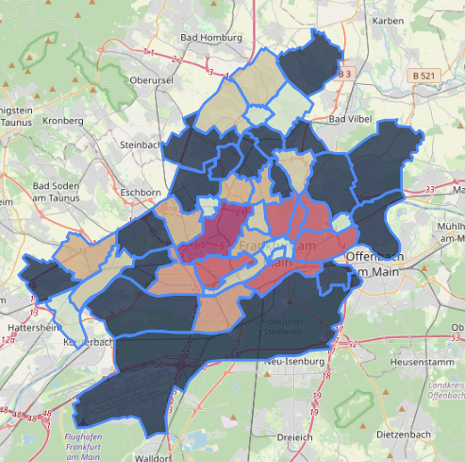
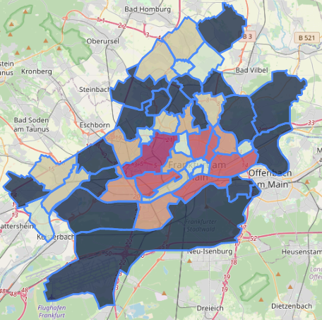
Analysis II
Choropleth map of total pupulation
Choropleth map of population aged 18 to 64
Focus on districts with high population in target age group
Gallus,
Sachsenhausen-Nord,
Ostend

Slide 8
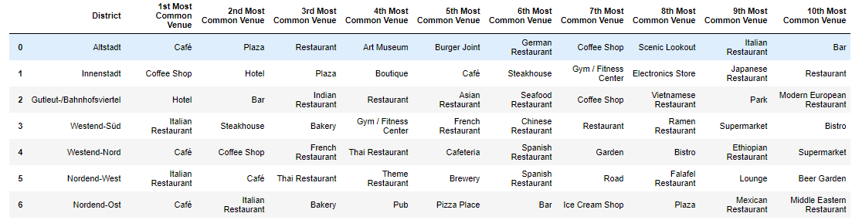
Analysis III
Analysis of the most common venues in three categories with a 10-digit score system.
Closeness to Public Transportation: 1 far and few possibilities, 10 close and many possibilities
Commonness of Cafes: 1 very common, 10 uncommon
Commonness of Hotels: 1 uncommon, 10 very common

Slide 9
Analysis IV
Gallus would be the ideal district!

Slide 10
Conclusion
Built a model to cluster districts into groups.
Implemented a geographical, demographical and point based system to indentify good candidates for a cafe location.
Three suitable possibilities for customer to choose from with one clear top candidate.

